Slide 1
Special issue in Physical Communications Cognitive Radio for LTE Advanced and Beyond Guest Editors: Linda Doyle Luiz DaSilva Baris Ozgul Tim Forde

Slide 2
Special Issue
Special issue of Physical Communications– The special issue will be called ‘Cognitive Radio for LTE Advanced and Beyond’.
The guest editors have decided to try some kind of a different approach in which we circulate a letter from the editors with the call. This is part of an attempt to push cognitive radio in a somewhat different direction– an excerpt is on the next slide
This relates to pushing cognitive radio and cognitive networks in different directions.

Slide 3
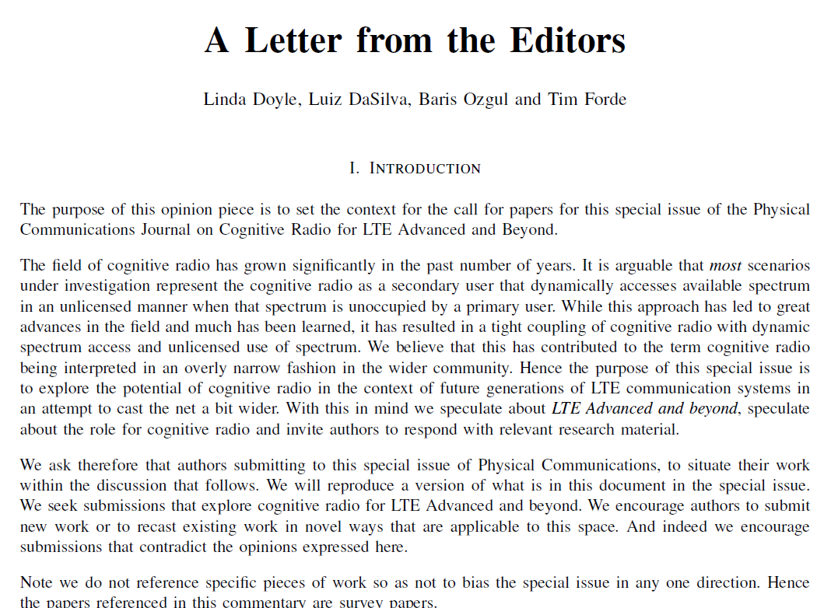
FULL LETTER ATTACHED IF ANYONE WANTS TO SEE

