Slide 1
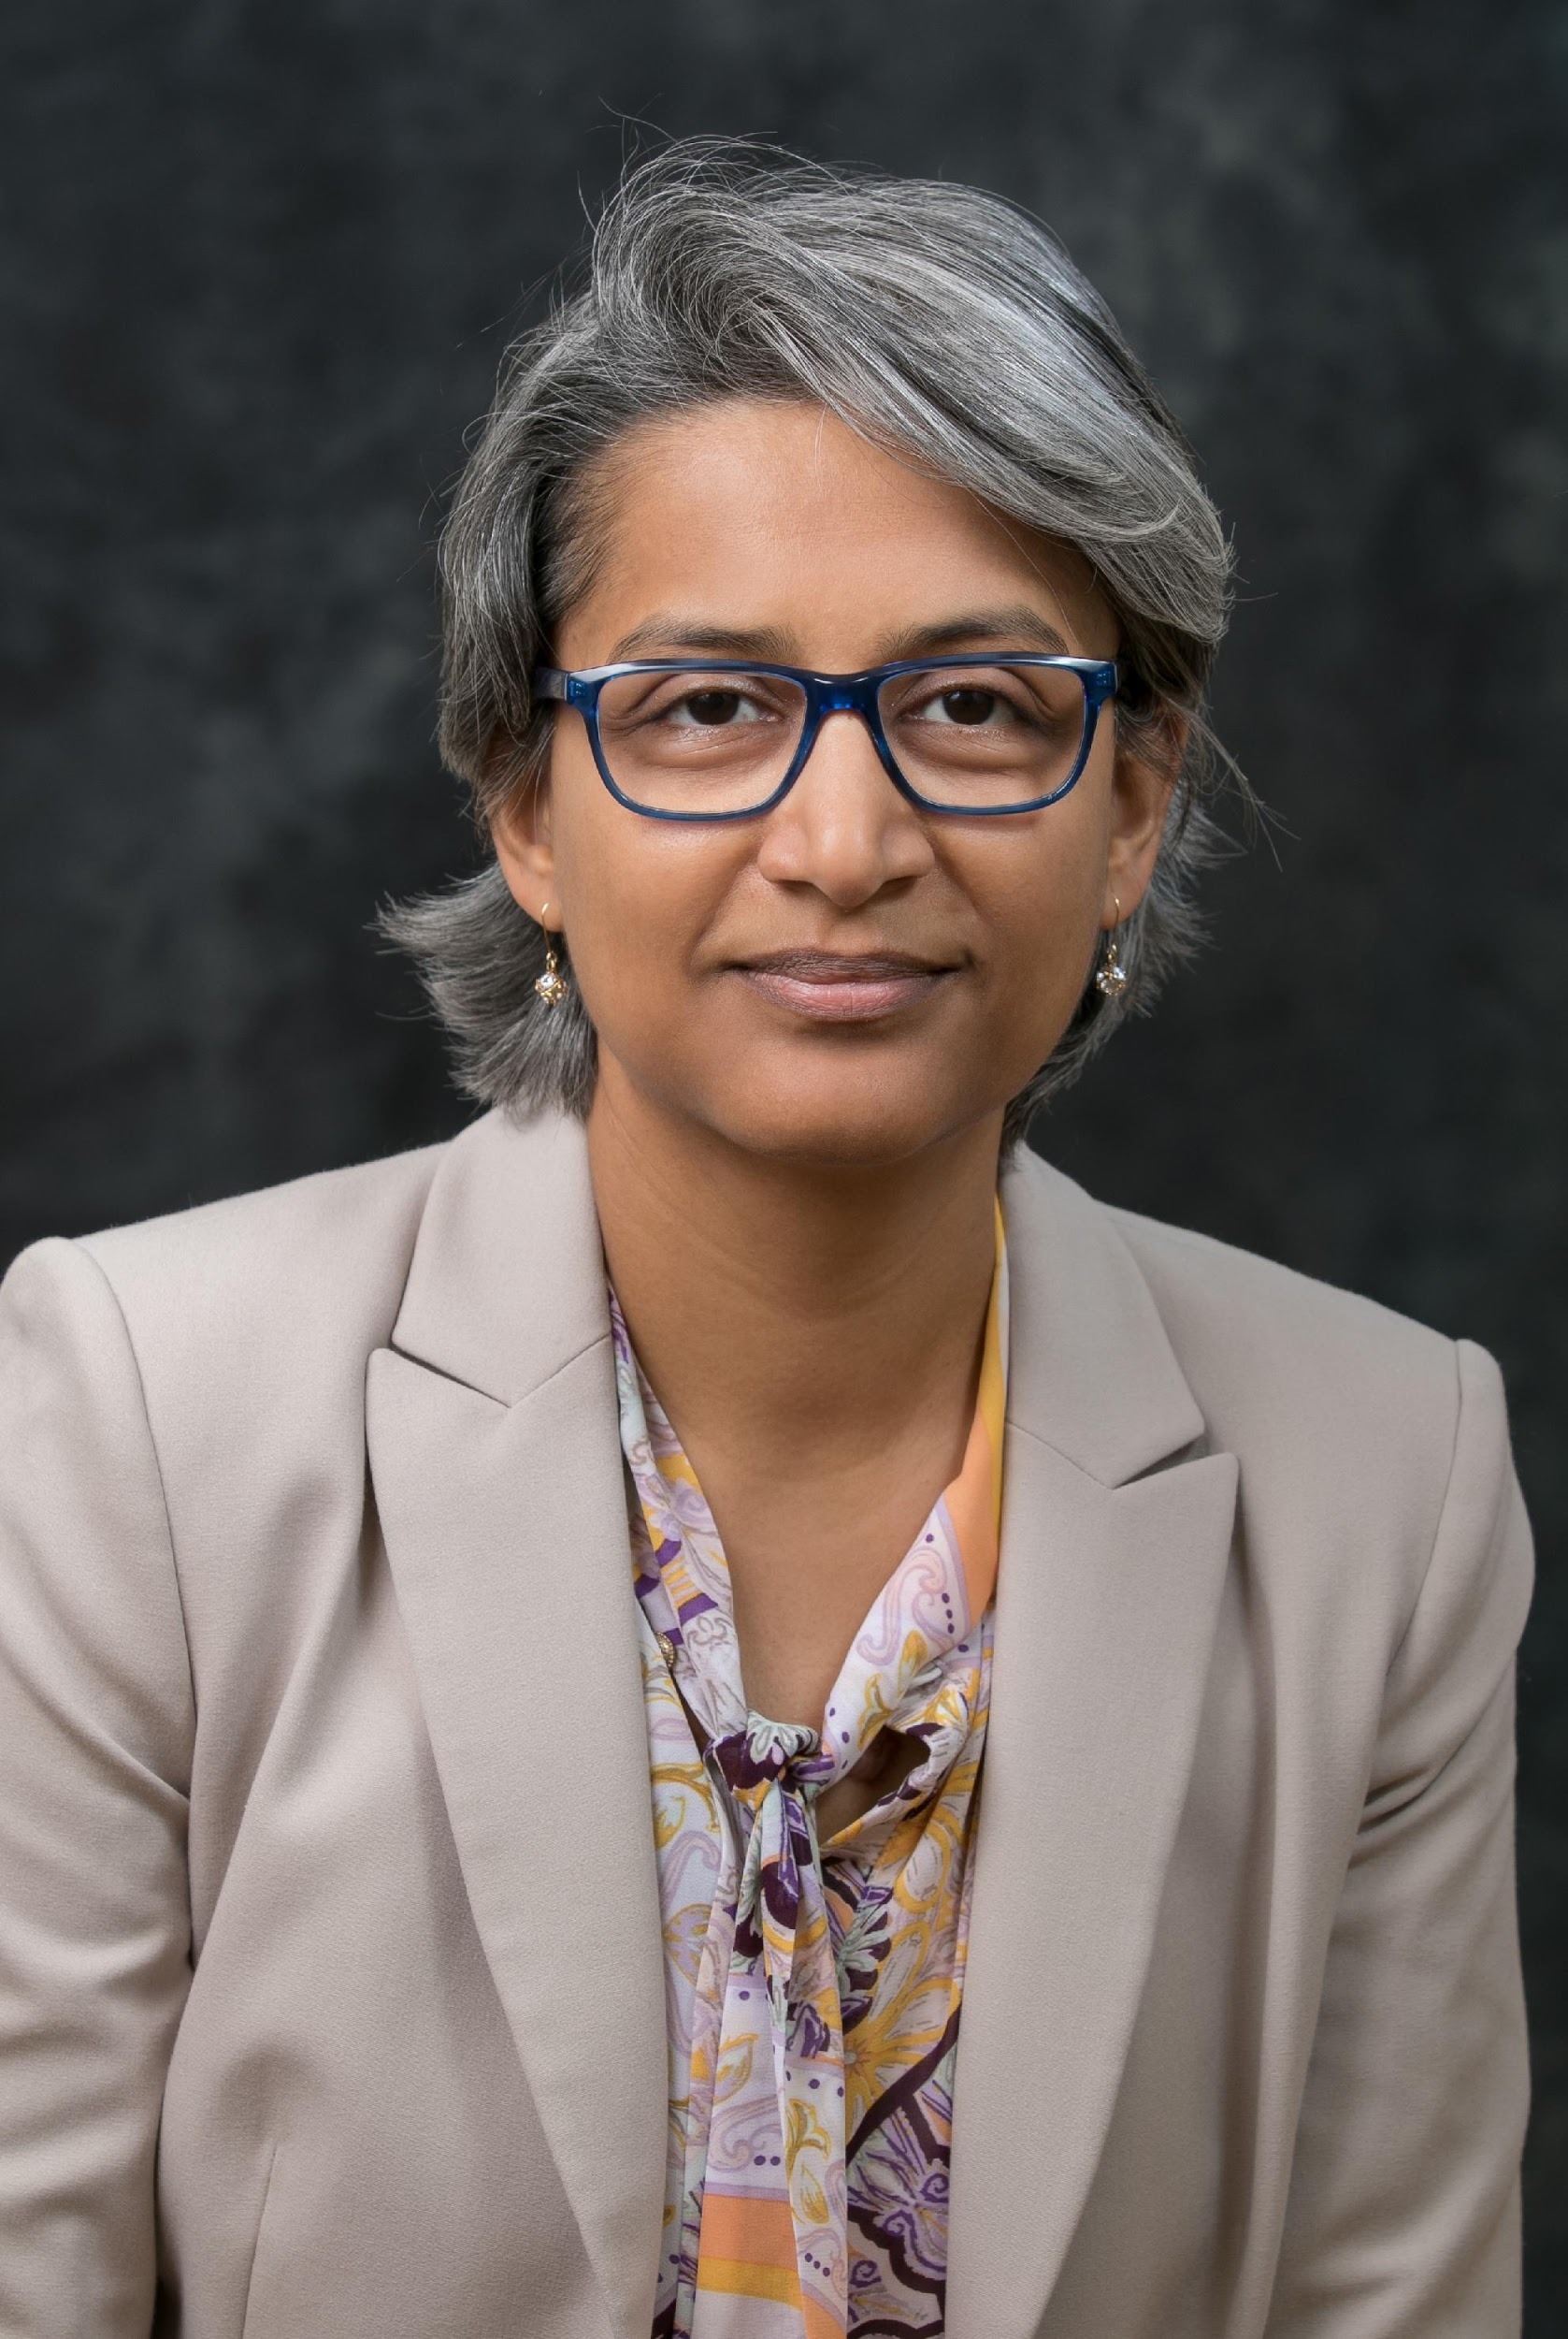
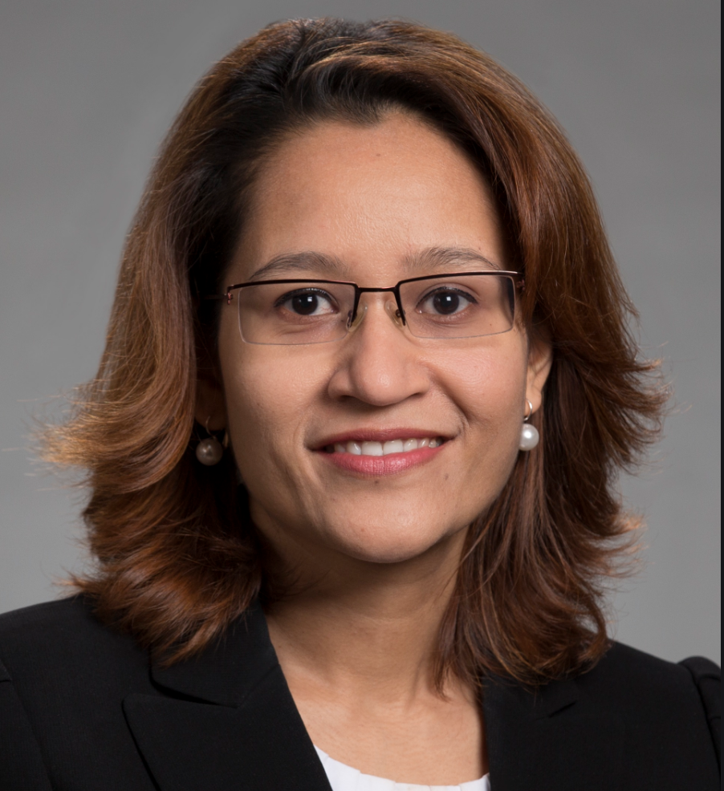
Chair: Prof. K.P. (Suba) Subbalakshmi,
Fellow National Academy of Inventors
Stevens Institute of Technology,
Jefferson Science Fellow
ksubbala@stevens.edu;
http://www.kpsuba.com
Vice Chair:
Prof. Dola Saha,
University at Albany, SUNY
dsaha@albany.edu
https://www.albany.edu/faculty/dsaha/

Slide 2
Introduction to the AIMLSec-IG
Currently 383 members in LinkedIn
To join AIMLSec-IG, use the LinkedIn group:
  http://www.linkedin.com/groups?home=&gid=5070076&trk=anet_ug_hm
  The group is also searchable under the name of IEEE Special Interest Group on AI and ML in Security in LinkedIn.
  You can also send an e-mail to ksubbala@stevens.edu or dsaha@albany.edu

Slide 3
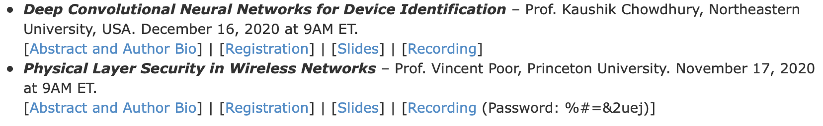
Virtual Seminar Series - 2020
Started virtual seminars when traveling was restricted due to COVID
Inaugural Speaker: Prof. Vincent Poor (Nov, 2021)

Slide 4
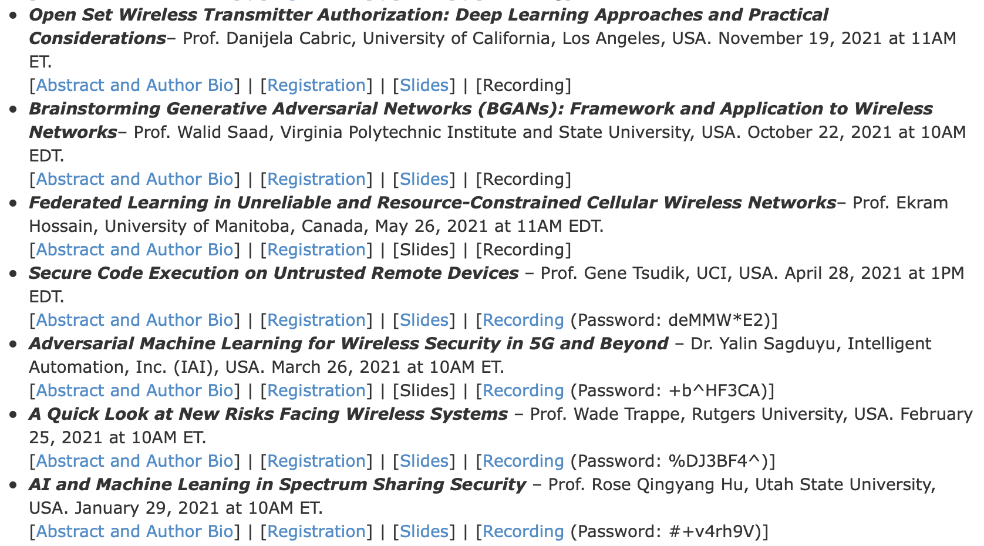
Virtual Seminar Series - 2021

Slide 5
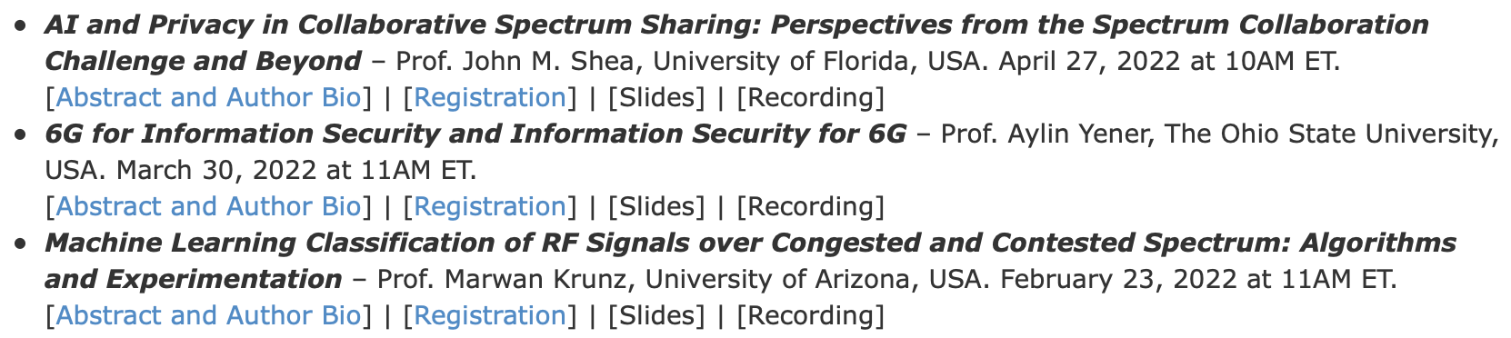
Virtual Seminar Series - 2022
Topic or Speaker Suggestions: Please email us (ksubbala@stevens.edu or dsaha@albany.edu).

Slide 6
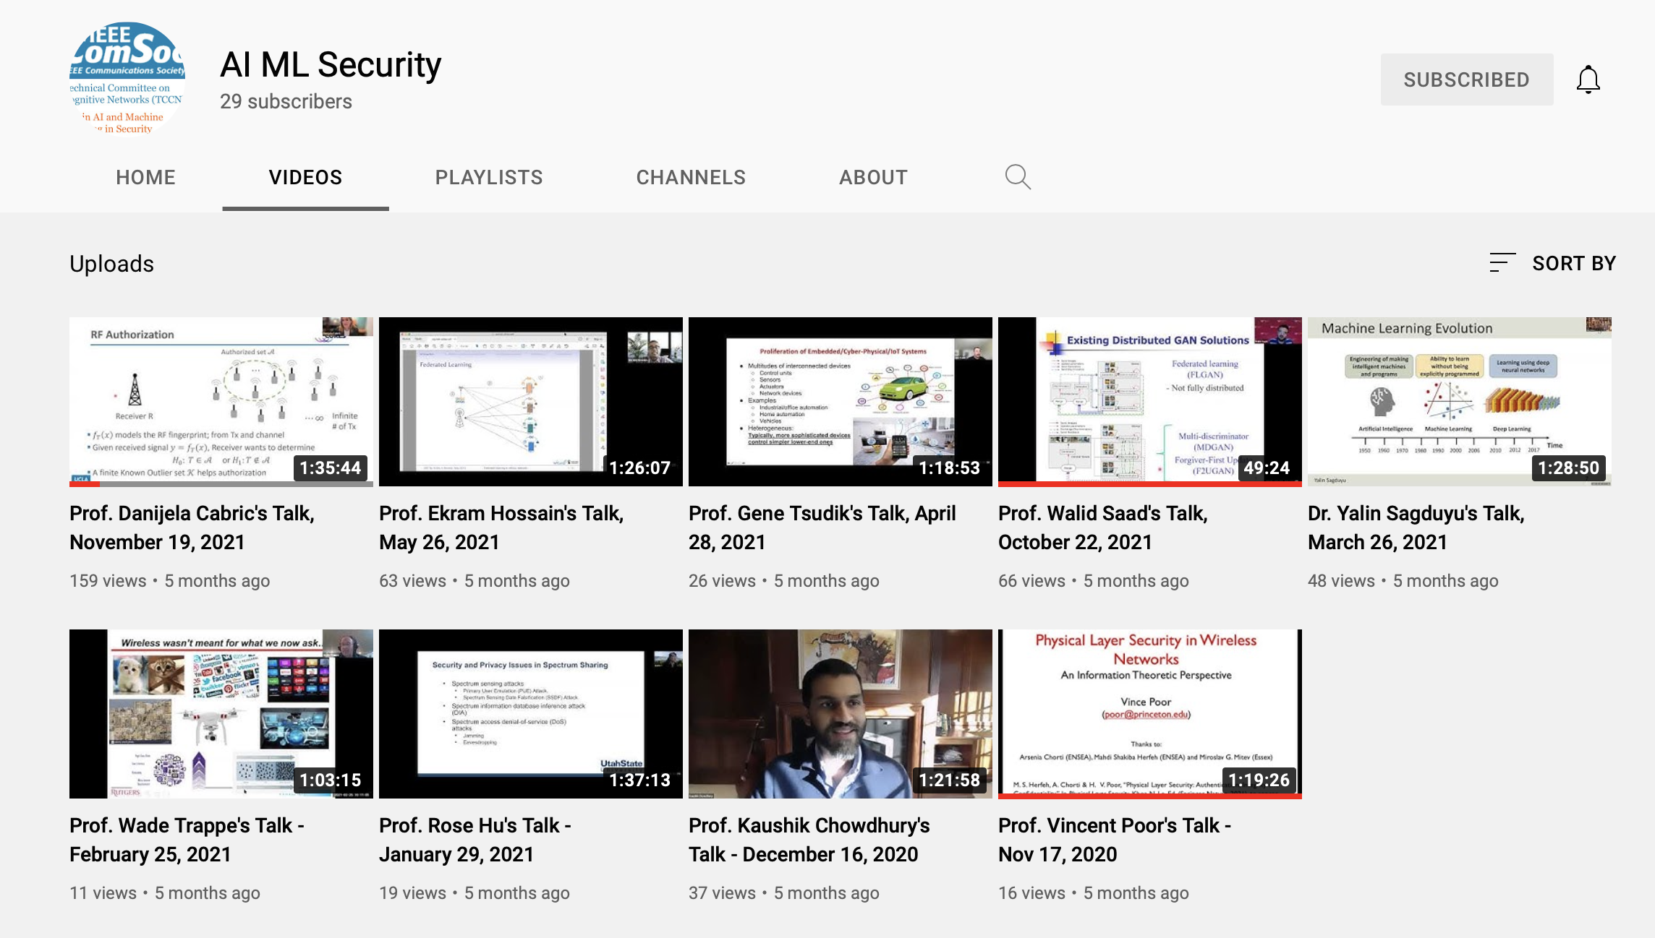
YouTube Channel
The YouTube Channel for the AIMLSec Webinar series is up and running.
https://www.youtube.com/channel/UCsDvVnQCC5QclwpyL7J1FFA

Slide 7
Other Activities of AIMLSec-IG
AIMLSec-IG chair is an AE for IEEE Transactions on AI
AIMLSec-IG chair is an AE for IEEE Transactions on Neural Networks and Learning System (TNNLS)
AIMLSec-IG chair is a Guest Editor in IEEE Transactions on AI on “Explainable and Interpretable AI” https://www.kpsuba.com/activities/ieee-tai-special-issue
Group members regularly publish in IEEE Transactions on Cognitive Communications and Networks (TCCN)
Group members have served as AE for IEEE TCCN

